Slide 1
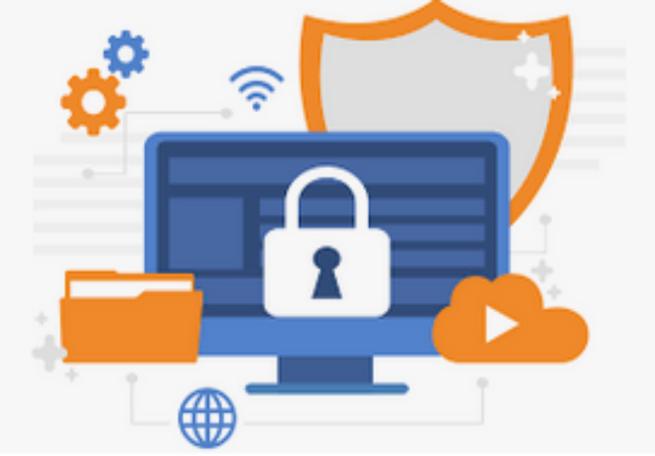
Unit 6.1 - Data Security
Prepared by: Koh Kian Hua

Slide 2
Objectives
After completing this unit, students should be able to:
Explain the difference between the terms security, privacy and integrity of data
Show appreciation of the need for both the security of data and the security of the computer system
Describe security measures designed to protect computer systems, ranging from the stand-alone PC to a network of computers including user accounts, passwords, authentication techniques such as digital signatures, firewall, antivirus software, anti-spyware, encryption.
Show understanding of the threats to computer and data security posed by networks and the internet including malware (virus, spyware), hackers, phishing, pharming.
Describe methods that can be used to restrict the risks posed by threats.
Describe security methods designed to protect the security of data including encryption, access rights.

Slide 3
Data Privacy
Data Privacy and Data Protection
Data privacy is defined as the protection of personal data from those who should not have access to it and the ability of individuals to determine who can access their personal information..
Data privacy can be achieved by establishing data protection laws. There are generally 8 guiding principles of data protection.
Guilding Principles of Data Protection
1. Data must be fairly and lawfully processed. | 5. Data must not be kept longer than necessary.
2. Data can only be processed for the stated purpose. | 6. Data must be processed in accordance with the data subject’s rights.
3. Data must be adequate, relevant and not excessive. | 7. Data must be kept secure.
4. Data must be accurate. | 8. Data must not be transferred to another country unless that country also has adequate protection.

Slide 4
Data Privacy
Preventing Data Loss & Restricting Access
Data security: refers to the prevention of unauthorised access to data, as well as to the data recovery methods if it is lost.
Data security can be achieved through
  User Account Authentication (eg: screen prompt for username and password)
  User Account Access Rights (eg: each user account is linked to the appropriate level of access)
  Use of Passwords (eg: restrict access to data or systems)
  Digital Signatures (eg: electronic signature for user authentication)
  Firewalls (eg: network security system to monitor network traffic)
  Antivirus Software / Anti-Spyware
  Encryption (eg: converting data into a code to prevent authorised access)

Slide 5
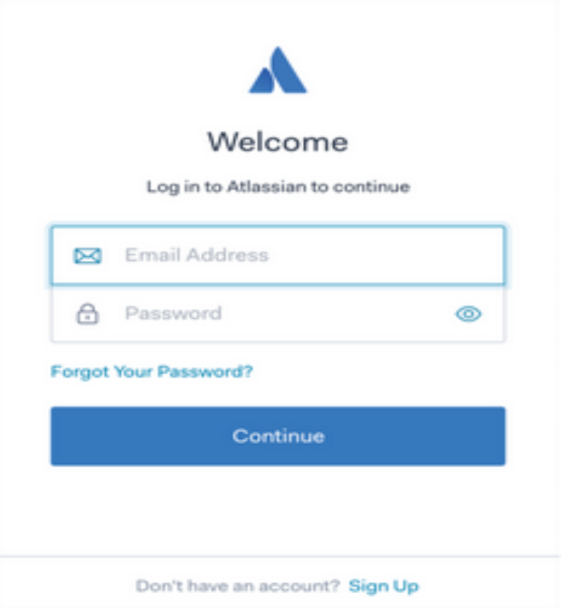
Data Privacy
Password Authentication
Login Screen
Authentication is the process of verifying who a user claims to be.
There are three factors of authentication:
What you know — Something you know, such as a password, PIN, personal information like mother's maiden name, etc.
What you have — A physical item you have, such as a cell phone or a card.
What you are — Biometric data, such as fingerprint, retina scan, etc.

Slide 6
Data Privacy
Password Authentication
A strong and unique password should be used so that it's harder for an attacker to guess.
To ensure password safety, the longer and more complex the password is, the better.
It's a good practice to enforce certain minimum requirements when asking users to create a new password.
To enforce password strength, a set of rules can be enforced to decide what a password must satisfy.

Slide 7
Data Privacy
Password Authentication
Password should be secure and this can be achieved through:
Running anti-spyware to ensure password is not relayed to unauthorised person
Changing the password regularly
Making sure password are difficult to guess or crack
Passwords are grouped as either strong (hard to crack or guess) or weak.
Strong passwords should contain:
at least one capital letter
at least one numerical value
at least one other keyboard character (such as @, *, &)

Slide 8
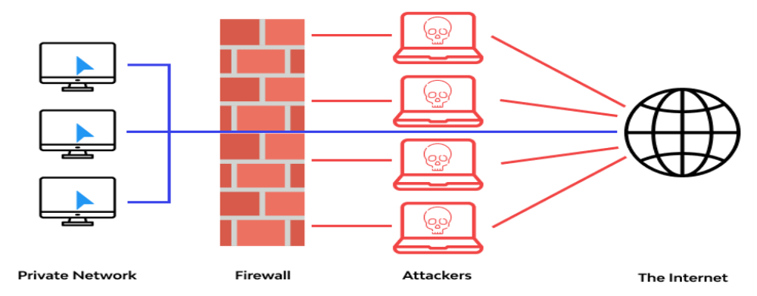
Data Privacy
Use of Firewalls
In computing, a firewall is a network security system that monitors and controls incoming and outgoing network traffic based on predetermined security rules.
A firewall establishes a barrier between a trusted network and an untrusted network, such as the Internet.

Slide 9
Data Privacy
Use of Firewalls
Firewall itself has several functions to protect computer networks that can be described in the following points:
Examining the traffic between the user’s computer and a public network (such as the internet)
Checking whether incoming or outgoing data meets a given set of criteria
Blocking the traffic if the data fails to meet the criteria, and inform user of the security issue
Logging all incoming and outgoing traffic to allow check later by the network administrator
Preventing access to certain undesirable sites
Helping to prevent viruses or hackers entering the user’s computer
Warning the user if some software on their system is trying to access an external data source.

Slide 10
Data Privacy
Use of Firewalls
What a Firewall Cannot Do: It is important to note that a properly configured firewall cannot protect you from the following dangers.
Prevent individuals, on internal networks, using their own modems to by-pass the firewall
Control employee misconduct or carelessness (for example, control of passwords or user accounts)
Prevent users on stand-alone computers from disabling the firewall.

Slide 11
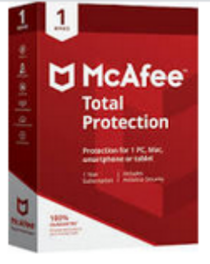
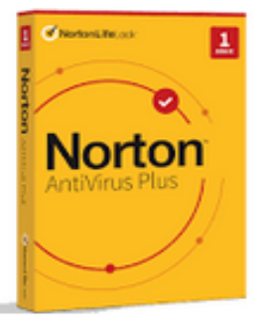
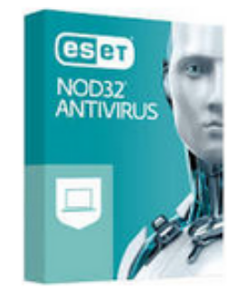
Data Privacy
Anti-virus Software
Antivirus Software is a kind of software used to prevent, scan, detect and delete viruses from a computer.
Most antivirus software runs automatically in the background to provide real-time protection against virus attacks.
McAfee Antivirus
Norton Antivirus
NOD32 Antivirus

Slide 12
Data Privacy
Anti-virus Software
All antivirus software performs the common function listed below.
Check software or files before they are run or loaded on a computer
Compare possible viruses against a database of known viruses
Check software for behaviour that could indicate a virus.
Quarantine files or programs which are possibly infected and allow user to decide when to delete the infected file
Antivirus software needs to be kept up to date as new viruses are constantly being discovered.
It may be necessary to form a full system scan once a week as some viruses remain dormant and would only be picked up by this full system scan.

Slide 13
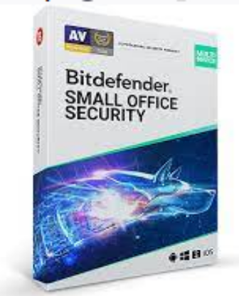
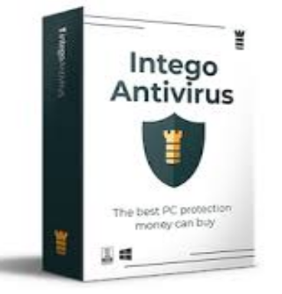
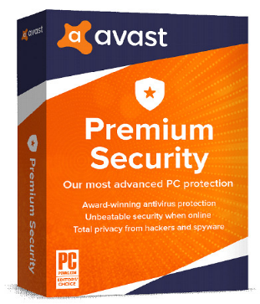
Data Privacy
Anti-Spyware Software
Anti-spyware software is a type of program designed to prevent and detect unwanted spyware program installations and to remove those programs if installed.
Detection may be either rules-based or based on downloaded definition files that identify currently active spyware programs.
Bit-Defender
Intego
Avast

Slide 14
Data Privacy
Encryption
Encryption is the method by which data or information is converted into secret code that hides the information's true meaning.
This cannot stop a hacker from deleting the data files, but it will stop them using the data for themselves.
In computing, unencrypted data is also known as plaintext, and encrypted data is called ciphertext.
Some examples of encryption software includes:
  Axcrypt
  Folderlock
  CryptoForge

Slide 15
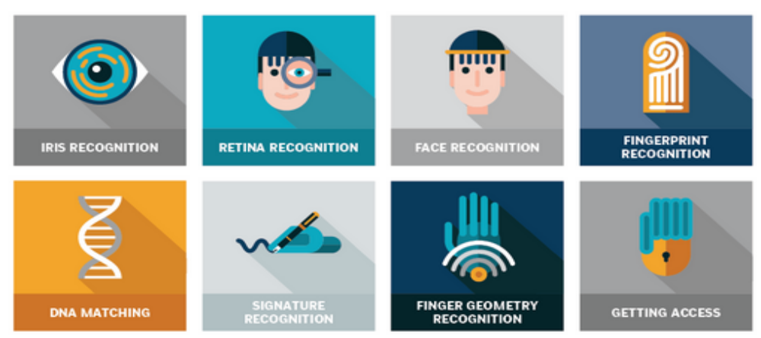
Data Privacy
Biometrics
Biometrics are biological measurements, or physical characteristics that can be used to identify individuals.
Example of biometrics include: fingerprint mapping, facial recognition, and retina scans are all forms of biometric technology, but these are just the most recognized options.

Slide 16
Data Privacy
Risk to Security of Stored Data
It is importnat to safeguard digital information throughout its entire life cycle to protect it from corruption, theft, or unauthorized access.
Some of the key risks to the security of stored data includes:
  Hacking (eg: illegal access to a computer without the user permission)
  Viruses (eg: code that replicate themselves with intention of corrupting or deleting files)
  Worms (eg: standalone virus that replicate themselves and spread to other computers)
  Logic Bombs (eg: code that activate in a computer when certain conditions are met)
  Trojan Horses (eg: malicious programs that disguise themselves as legitimate software)
  Spyware (eg: Software that gathers information by monitoring key presses on the user’s keyboard.)
  Phishing (eg: an attacker, acting as a trusted entity, fool a victim into opening an email, instant message, or text message)

Slide 17
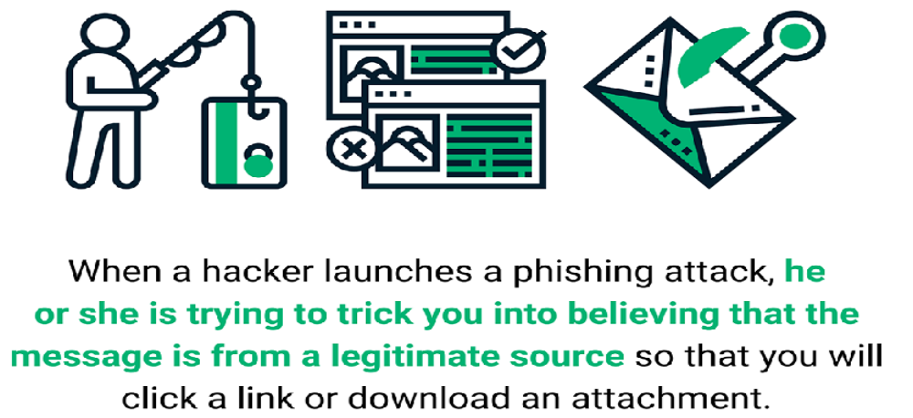
Data Privacy
Phishing
Phishing is a type of social engineering attack often used to steal user data, including login credentials and credit card numbers.

Slide 18
Data Privacy
Phishing
Phishing attacks are one of the most common security challenges that both individuals and companies face in keeping their information secure.
Some ways to reduce the risk of phishing attacks are listed below:
  Users need to undergo frequent security awareness training to become aware of how to identify phishing scams.
  Do not click on links unless certain that it is safe to do so.
  Run anti-phishing toolbars on web browsers to alert the user to malicious websites contained in an email.
  Look out for https and/or the green padlock symbol in the address bar (both suggest that traffic to and from the website is encrypted).
  Regularly check online accounts and frequently change passwords.
  Ensure an up-to-date browser, with all of the latest security upgrades.
  Use a combination of a desktop firewall (usually software) and a network firewall (usually hardware) to reduce phishing risk.

Slide 19
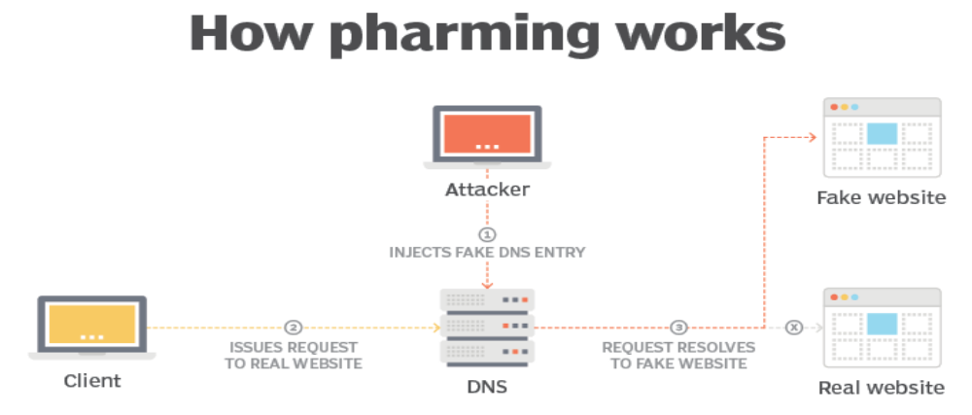
Data Privacy
Pharming
Pharming is a cyberattack intended to redirect a website's traffic to another, fake site by installing a malicious program on the computer.
Pharming can be conducted either by changing the hosts file on a victim's computer or by exploitation of a vulnerability in DNS server software.

Slide 20
Data Privacy
Protection Against Pharming
The risks of pharming can be mitigated (reduced )by the following:
Using antivirus software, which can detect unauthorised alterations to a website address and warn the user
Using modern web browsers that alert users to pharming and phishing attacks
Checking the spelling of websites
Checking for https and/or the green padlock symbol in the address bar.
Note: It is more difficult to mitigate (reduce) risk if the DNS server itself has been infected (rather than the user’s computer).

Slide 21
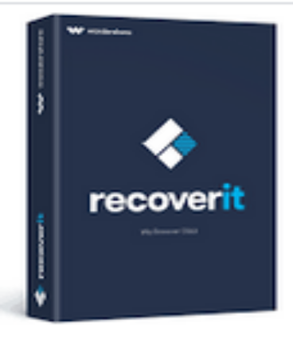
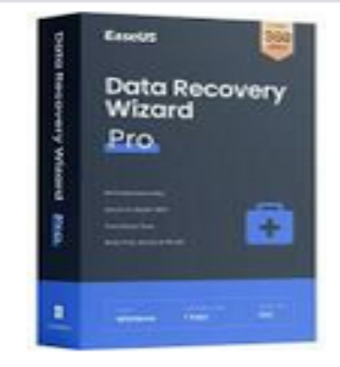
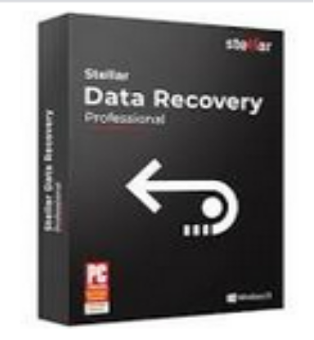
Data Privacy
Data Recovery
Data Recovery: a process of salvaging deleted, inaccessible, lost, corrupted, damaged, or formatted data from secondary storage, removable media or files, when the data stored in them cannot be accessed in a usual way.
Data Recovery Software
recoverit
EaseUS Data Recovery
Stellar Data Recovery

Slide 22
Data Privacy
Data Recovery
Strategies / Safeguards to minimize accidental loss of data such as accidental deletion of a file
  Use back-ups in case the data is lost or corrupted through an accidental operation
  Save data on a regular basis
  Use passwords and user IDs to restrict access to authorised users only

Slide 23
Data Privacy
Data Recovery
Strategies / Safeguards to minimize hardware fault such as head crash on a the hard-disk.
  Use back-ups in case data is lost or corrupted through the hardware fault
  Use uninterruptable power supply (USP) in case power loss causes hardware malfunction
  Save data on a regular basis
  Use parallel systems as back-up hardware

Slide 24
Data Privacy
Data Recovery
Strategies / Safeguards to minimize software fault such as incompatible software installed on the system.
  Use back-ups in case the data is lost or corrupted through the software fault
  Save data on a regular basis in case the software suddenly ‘freezes’ or ‘crashes’ while the user is working on it
Strategies / Safeguards to minimize incorrect computer operation such as incorrect shutdown / procedure for removing USB drive.
  Use back-ups in case data is lost or corrupted through wrong operation
  Correct training procedures so users are aware of the correct operation of hardware

Slide 25
Data Privacy
Class Activity
A company has offices in four different countries. Communication and data sharing between the offices is done via computers connecting over the internet.
Describe three data security issues the company might encounter during their day to day communications and data sharing
2. Define these three terms.
  a) Worm
  b) Logic bomb
  c) Trojan horse

